Slide 1
CS162 Operating Systems and Systems Programming Lecture 10 Scheduling
February 24th, 2016
Prof. Anthony D. Joseph
http://cs162.eecs.Berkeley.edu

Slide 2
Recall: Scheduling Policy Goals/Criteria
Minimize Response Time
Minimize elapsed time to do an operation (or job)
Response time is what the user sees:
Time to echo a keystroke in editor
Time to compile a program
Real-time Tasks: Must meet deadlines imposed by World
Maximize Throughput
Maximize operations (or jobs) per second
Throughput related to response time, but not identical:
Minimizing response time will lead to more context switching than if you only maximized throughput
Two parts to maximizing throughput
Minimize overhead (for example, context-switching)
Efficient use of resources (CPU, disk, memory, etc)
Fairness
Share CPU among users in some equitable way
Fairness is not minimizing average response time:
Better average response time by making system less fair
Notes:
What does CPU scheduling have to do with efficient use of the disk?
A lot! Have to have the CPU to make a disk request
Fairness: Minimize # of angry phone calls? Minimize my response time?

Slide 3
Recall: First-Come, First-Served (FCFS) Scheduling
First-Come, First-Served (FCFS)
Also “First In, First Out” (FIFO) or “Run until done”
In early systems, FCFS meant one program scheduled until done (including I/O)
Now, means keep CPU until thread blocks
Example: Process Burst Time P₁ 24 P₂ 3 P₃ 3
Suppose processes arrive in the order: P₁ , P₂ , P₃ The Gantt Chart for the schedule is:
Waiting time for P₁ = 0; P₂ = 24; P₃ = 27
Average waiting time: (0 + 24 + 27)/3 = 17
Average Completion time: (24 + 27 + 30)/3 = 27
Convoy effect: short process behind long process
P₁
P₂
P₃
0
24
27
30

Slide 4
Recall: FCFS Scheduling (Cont.)
Example continued:
Suppose that processes arrive in order: P₂ , P₃ , P₁ Now, the Gantt chart for the schedule is:
Waiting time for P₁ = 6; P₂ = 0; P₃ = 3
Average waiting time: (6 + 0 + 3)/3 = 3
Average Completion time: (3 + 6 + 30)/3 = 13
In second case:
average waiting time is much better (before it was 17)
Average completion time is better (before it was 27)
FIFO Pros and Cons:
Simple (+)
Short jobs get stuck behind long ones (-)
Safeway: Getting milk, always stuck behind cart full of small items. Upside: get to read about space aliens!
P₂
P₃
P₁
0
3
6
30

Slide 5
Round Robin (RR)
FCFS Scheme: Potentially bad for short jobs!
Depends on submit order
If you are first in line at supermarket with milk, you don’t care who is behind you, on the other hand…
Round Robin Scheme
Each process gets a small unit of CPU time (time quantum), usually 10-100 milliseconds
After quantum expires, the process is preempted and added to the end of the ready queue.
n processes in ready queue and time quantum is q ⇒
Each process gets 1/n of the CPU time
In chunks of at most q time units
No process waits more than (n-1)q time units
Performance
q large ⇒ FCFS
q small ⇒ Interleaved (really small ⇒ hyperthreading?)
q must be large with respect to context switch, otherwise overhead is too high (all overhead)

Slide 6
Example of RR with Time Quantum = 20
Example: Process Burst Time P₁ 53 P₂ 8 P₃ 68 P₄ 24
The Gantt chart is:
Waiting time for P₁=(68-20)+(112-88)=72 P₂=(20-0)=20 P₃=(28-0)+(88-48)+(125-108)=85 P₄=(48-0)+(108-68)=88
Average waiting time = (72+20+85+88)/4=66¼
Average completion time = (125+28+153+112)/4 = 104½
Thus, Round-Robin Pros and Cons:
Better for short jobs, Fair (+)
Context-switching time adds up for long jobs (-)
P₁
P₂
P₃
P₄
P₁
P₃
P₄
P₁
P₃
P₃
0
20
28
48
68
88
108
112
125
145
153

Slide 7
Round-Robin Discussion
How do you choose time slice?
What if too big?
Response time suffers
What if infinite (∞)?
Get back FIFO
What if time slice too small?
Throughput suffers!
Actual choices of timeslice:
Initially, UNIX timeslice one second:
Worked ok when UNIX was used by one or two people.
What if three compilations going on? 3 seconds to echo each keystroke!
In practice, need to balance short-job performance and long-job throughput:
Typical time slice today is between 10ms – 100ms
Typical context-switching overhead is 0.1ms – 1ms
Roughly 1% overhead due to context-switching

Slide 8
Comparisons between FCFS and Round Robin
Assuming zero-cost context-switching time, is RR always better than FCFS?
Simple example: 10 jobs, each take 100s of CPU time RR scheduler quantum of 1s All jobs start at the same time
Completion Times:
Both RR and FCFS finish at the same time
Average response time is much worse under RR!
Bad when all jobs same length
Also: Cache state must be shared between all jobs with RR but can be devoted to each job with FIFO
Total time for RR longer even for zero-cost switch!
Job # | FIFO | RR
1 | 100 | 991
2 | 200 | 992
… | … | …
9 | 900 | 999
10 | 1000 | 1000

Slide 9
Earlier Example with Different Time Quantum
P₂
[8]
P₄
[24]
P₁
[53]
P₃
[68]
Best FCFS:
0
8
32
85
153
Quantum
P₁
P₂
P₃
P₄
Average
Wait
Time
Best FCFS
32
0
85
8
31¼
Q = 1
84
22
85
57
62
Q = 5
82
20
85
58
61¼
Q = 8
80
8
85
56
57¼
Q = 10
82
10
85
68
61¼
Q = 20
72
20
85
88
66¼
Worst FCFS
68
145
0
121
83½
Completion
Time
Best FCFS
85
8
153
32
69½
Q = 1
137
30
153
81
100½
Q = 5
135
28
153
82
99½
Q = 8
133
16
153
80
95½
Q = 10
135
18
153
92
99½
Q = 20
125
28
153
112
104½
Worst FCFS
121
153
68
145
121¾

Slide 10
Handling Differences in Importance: Strict Priority Scheduling
Priority 3
Job 1
Job 2
Job 3
Priority 2
Job 4
Priority 1
Priority 0
Job 5
Job 6
Job 7
Execution Plan
Always execute highest-priority runable jobs to completion
Each queue can be processed in Round-Robin fashion with some time-quantum
Problems:
Starvation:
Lower priority jobs don’t get to run because higher priority tasks always running
Deadlock: Priority Inversion
Not strictly a problem with priority scheduling, but happens when low priority task has lock needed by high-priority task
Usually involves third, intermediate priority task that keeps running even though high-priority task should be running
How to fix problems?
Dynamic priorities – adjust base-level priority up or down based on heuristics about interactivity, locking, burst behavior, etc…

Slide 11
Scheduling Fairness
What about fairness?
Strict fixed-priority scheduling between queues is unfair (run highest, then next, etc):
long running jobs may never get CPU
In Multics, shut down machine, found 10-year-old job
Must give long-running jobs a fraction of the CPU even when there are shorter jobs to run
Tradeoff: fairness gained by hurting avg response time!
How to implement fairness?
Could give each queue some fraction of the CPU
What if one long-running job and 100 short-running ones?
Like express lanes in a supermarket—sometimes express lanes get so long, get better service by going into one of the other lines
Could increase priority of jobs that don’t get service
What is done in some variants of UNIX
This is ad hoc—what rate should you increase priorities?
And, as system gets overloaded, no job gets CPU time, so everyone increases in priority⇒Interactive jobs suffer

Slide 12
Administrivia
Midterm coming up soon
Wednesday 3/9 6-7:30PM in 10 EVANS and 155 DWINELLE
Rooms assignment: aa-eh 10 Evans, ej-oa 155 Dwinelle
Closed book, no calculators, one double-side page of handwritten notes
No class that day, extra office hours
Review session TBA on Sat or Sun afternoon
Topics will include the material through lecture 12 (Wed 3/2)
Includes lectures, project 1, homeworks, readings, textbook
Apple Core OS Tech Talk Infosession next week
Tuesday, March 1 6:15 – 7:30PM in Woz Lounge

Slide 13
BREAK

Slide 14
Lottery Scheduling
Yet another alternative: Lottery Scheduling
Give each job some number of lottery tickets
On each time slice, randomly pick a winning ticket
On average, CPU time is proportional to number of tickets given to each job
How to assign tickets?
To approximate SRTF, short running jobs get more, long running jobs get fewer
To avoid starvation, every job gets at least one ticket (everyone makes progress)
Advantage over strict priority scheduling: behaves gracefully as load changes
Adding or deleting a job affects all jobs proportionally, independent of how many tickets each job possesses

Slide 15
Lottery Scheduling Example
Lottery Scheduling Example
Assume short jobs get 10 tickets, long jobs get 1 ticket
What if too many short jobs to give reasonable response time?
If load average is 100, hard to make progress
One approach: log some user out
# short jobs/ # long jobs | % of CPU each short jobs gets | % of CPU each long jobs gets
1/1 | 91% | 9%
0/2 | N/A | 50%
2/0 | 50% | N/A
10/1 | 9.9% | 0.99%
1/10 | 50% | 5%

Slide 16
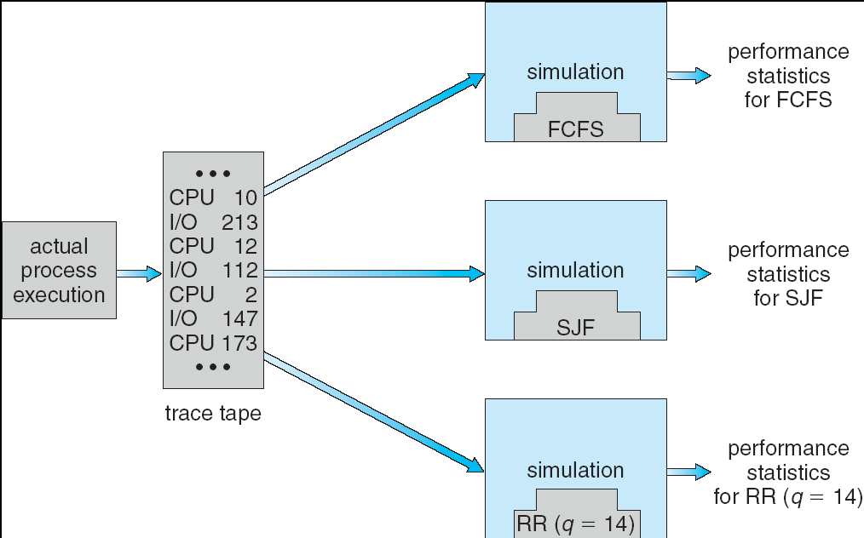
How to Evaluate a Scheduling algorithm?
Deterministic modeling
takes a predetermined workload and compute the performance of each algorithm for that workload
Queueing models
Mathematical approach for handling stochastic workloads
Implementation/Simulation:
Build system which allows actual algorithms to be run against actual data. Most flexible/general.

Slide 17
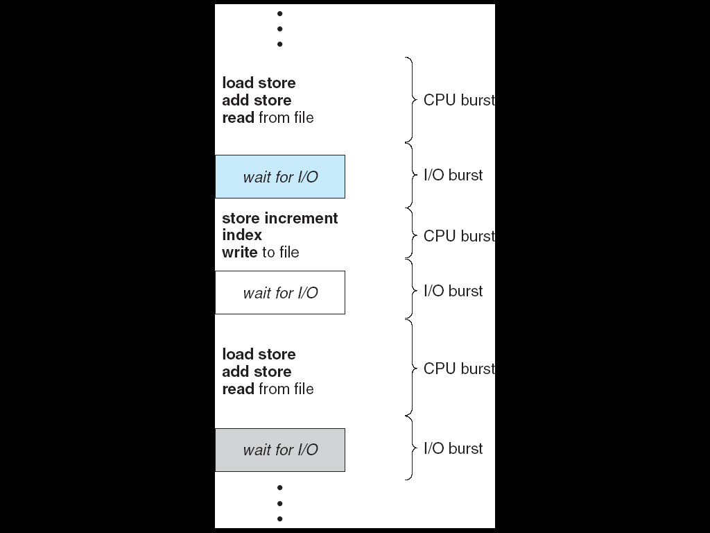
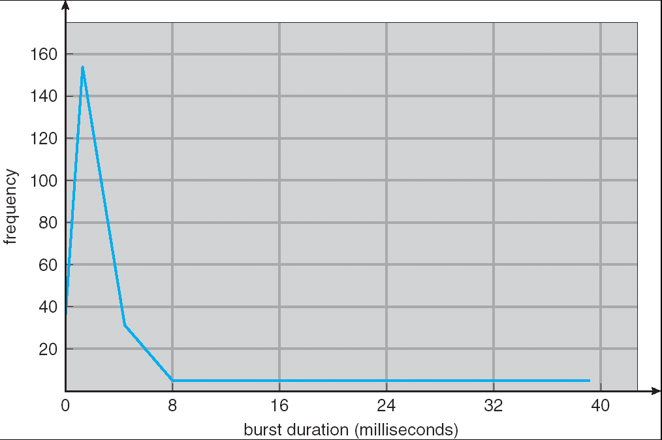
Recall: Assumption – CPU Bursts
Weighted toward small bursts
Execution model: programs alternate between bursts of CPU and I/O
Program typically uses the CPU for some period of time, then does I/O, then uses CPU again
Each scheduling decision is about which job to give to the CPU for use by its next CPU burst
With timeslicing, thread may be forced to give up CPU before finishing current CPU burst

Slide 18
How to Handle Simultaneous Mix of Diff Types of Apps?
Can we use Burst Time (observed) to decide which application gets CPU time?
Consider mix of interactive and high throughput apps:
How to best schedule them?
How to recognize one from the other?
Do you trust app to say that it is “interactive”?
Should you schedule the set of apps identically on servers, workstations, pads, and cellphones?
Assumptions encoded into many schedulers:
Apps that sleep a lot and have short bursts must be interactive apps – they should get high priority
Apps that compute a lot should get low(er?) priority, since they won’t notice intermittent bursts from interactive apps
Hard to characterize apps:
What about apps that sleep for a long time, but then compute for a long time?
Or, what about apps that must run under all circumstances (say periodically)

Slide 19
What if we Knew the Future?
Could we always mirror best FCFS?
Shortest Job First (SJF):
Run whatever job has the least amount of computation to do
Sometimes called “Shortest Time to Completion First” (STCF)
Shortest Remaining Time First (SRTF):
Preemptive version of SJF: if job arrives and has a shorter time to completion than the remaining time on the current job, immediately preempt CPU
Sometimes called “Shortest Remaining Time to Completion First” (SRTCF)
These can be applied either to a whole program or the current CPU burst of each program
Idea is to get short jobs out of the system
Big effect on short jobs, only small effect on long ones
Result is better average response time
Notes:
Rich get richer, and poor get poorer = short jobs get through the system faster, long jobs take even longer

Slide 20
Discussion
SJF/SRTF are the best you can do at minimizing average response time
Provably optimal (SJF among non-preemptive, SRTF among preemptive)
Since SRTF is always at least as good as SJF, focus on SRTF
Comparison of SRTF with FCFS and RR
What if all jobs the same length?
SRTF becomes the same as FCFS (i.e. FCFS is best can do if all jobs the same length)
What if jobs have varying length?
SRTF (and RR): short jobs not stuck behind long ones

Slide 21
Example to illustrate benefits of SRTF
A or B
C
C’s
I/O
C’s
I/O
C’s
I/O
Three jobs:
A,B: both CPU bound, run for week C: I/O bound, loop 1ms CPU, 9ms disk I/O
If only one at a time, C uses 90% of the disk, A or B could use 100% of the CPU
With FIFO:
Once A or B get in, keep CPU for two weeks
What about RR or SRTF?
Easier to see with a timeline

Slide 22
SRTF Example continued:
Disk Utilization:
9/201 ~ 4.5%
C
A
B
C
RR 100ms time slice
Disk Utilization:
~90% but lots of wakeups!
C’s
I/O
C’s
I/O
CABAB…
C
RR 1ms time slice
C’s
I/O
C’s
I/O
Disk Utilization:
90%
C
A
A
A
SRTF
C’s
I/O
C’s
I/O

Slide 23
SRTF Further discussion
Starvation
SRTF can lead to starvation if many small jobs!
Large jobs never get to run
Somehow need to predict future
How can we do this?
Some systems ask the user
When you submit a job, have to say how long it will take
To stop cheating, system kills job if takes too long
But: Even non-malicious users have trouble predicting runtime of their jobs
Bottom line, can’t really know how long job will take
However, can use SRTF as a yardstick for measuring other policies
Optimal, so can’t do any better
SRTF Pros & Cons
Optimal (average response time) (+)
Hard to predict future (-)
Unfair (-)

Slide 24
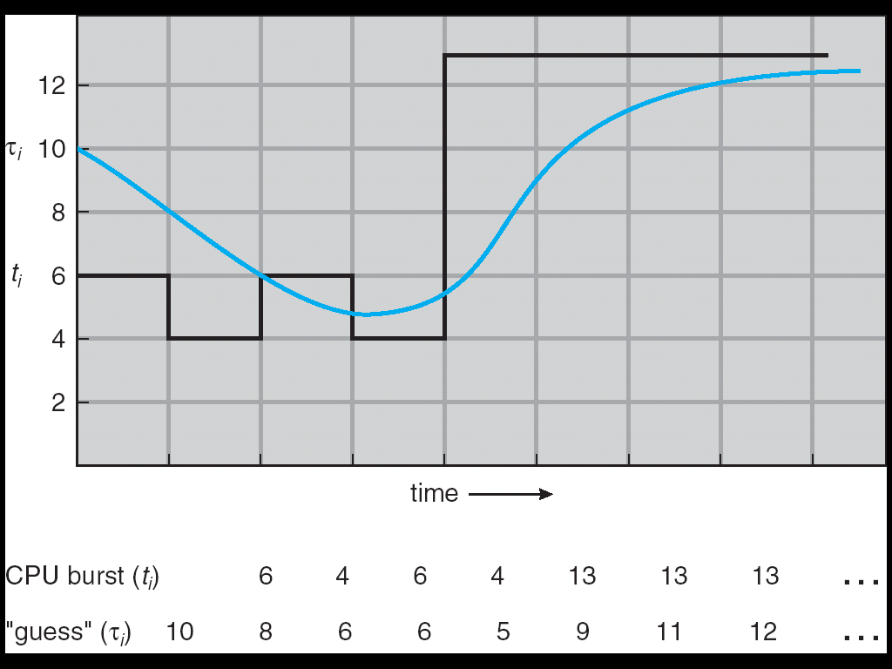
Predicting the Length of the Next CPU Burst
Adaptive: Changing policy based on past behavior
CPU scheduling, in virtual memory, in file systems, etc
Works because programs have predictable behavior
If program was I/O bound in past, likely in future
If computer behavior were random, wouldn’t help
Example: SRTF with estimated burst length
Use an estimator function on previous bursts: Let t_{n-1}, t_{n-2}, t_{n-3}, etc. be previous CPU burst lengths. Estimate next burst τ_{n} = f(t_{n-1}, t_{n-2}, t_{n-3}, …)
Function f could be one of many different time series estimation schemes (Kalman filters, etc)
For instance, exponential averaging τ_{n} = αt_{n-1}+(1-α)τ_{n-1} with (0<α≤1)

Slide 25
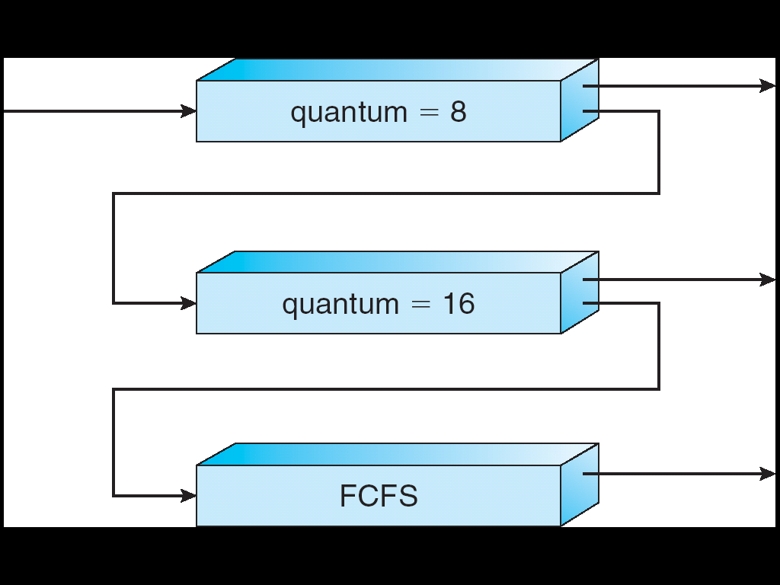
Multi-Level Feedback Scheduling
Another method for exploiting past behavior
First used in CTSS
Multiple queues, each with different priority
Higher priority queues often considered “foreground” tasks
Each queue has its own scheduling algorithm
e.g. foreground – RR, background – FCFS
Sometimes multiple RR priorities with quantum increasing exponentially (highest:1ms, next:2ms, next: 4ms, etc)
Adjust each job’s priority as follows (details vary)
Job starts in highest priority queue
If timeout expires, drop one level
If timeout doesn’t expire, push up one level (or to top)
Long-Running Compute Tasks Demoted to Low Priority

Slide 26
Scheduling Details
Result approximates SRTF:
CPU bound jobs drop like a rock
Short-running I/O bound jobs stay near top
Scheduling must be done between the queues
Fixed priority scheduling:
serve all from highest priority, then next priority, etc.
Time slice:
each queue gets a certain amount of CPU time
e.g., 70% to highest, 20% next, 10% lowest
Countermeasure: user action that can foil intent of the OS designer
For multilevel feedback, put in a bunch of meaningless I/O to keep job’s priority high
Of course, if everyone did this, wouldn’t work!
Example of Othello program:
Playing against competitor, so key was to do computing at higher priority the competitors.
Put in printf’s, ran much faster!

Slide 27
BREAK

Slide 28
Case Study: Linux O(1) Scheduler
Kernel/Realtime Tasks
User Tasks
0
100
139
Priority-based scheduler: 140 priorities
40 for “user tasks” (set by “nice”), 100 for “Realtime/Kernel”
Lower priority value ⇒ higher priority (for nice values)
Highest priority value ⇒ Lower priority (for realtime values)
All algorithms O(1) – schedule n processes in constant time
Compute timeslices/priorities/interactivity credits when job finishes time slice
140-bit bit mask indicates presence or absence of job(s) at given priority level
Two separate priority queues (arrays): “active” and “expired”
All tasks in the active queue use up their timeslices and get placed on the expired queue, after which queues swapped
Timeslice depends on priority – linearly mapped onto timeslice range
Like multi-level queue (1 queue per priority) with diff timeslice at each level
Execution split into “Timeslice Granularity” chunks – RR through priority

Slide 29
O(1) Scheduler Continued
Heuristics
User-task priority adjusted ±5 based on heuristics
p->sleep_avg = sleep_time – run_time
Higher sleep_avg ⇒ more I/O bound the task, more reward (and vice versa)
Interactive Credit
Earned when task sleeps for “long” time, Spend when task runs for “long” time
IC is used to provide hysteresis to avoid changing interactivity for temporary changes in behavior
However, “interactive tasks” get special dispensation
To try to maintain interactivity
Placed back into active queue, unless another task has starved for too long…
Real-Time Tasks
Always preempt non-RT tasks and no dynamic adjustment of priorities
Scheduling schemes:
SCHED_FIFO: preempts other tasks, no timeslice limit
SCHED_RR: preempts normal tasks, RR scheduling amongst tasks of same priority

Slide 30
Linux Completely Fair Scheduler (CFS)
First appeared in 2.6.23, modified in 2.6.24
“CFS doesn’t track sleeping time and doesn’t use heuristics to identify interactive tasks—it just makes sure every process gets a fair share of CPU within a set amount of time given the number of runnable processes on the CPU.”
Inspired by Networking “Fair Queuing”
Each process given their fair share of resources
Models an “ideal multitasking processor” in which N processes execute simultaneously as if they truly got 1/N of the processor
Tries to give each process an equal fraction of the processor
Priorities reflected by weights such that increasing a task’s priority by 1 always gives the same fractional increase in CPU time – regardless of current priority

Slide 31
CFS (Continued)
Idea: track “virtual time” received by each process when it is running
Take real execution time, scale by weighting factor
Lower priority ⇒ real time divided by greater weight
Actually – multiply by sum of all weights/current weight
Keep virtual time advancing at same rate
Targeted latency (T_{L}): period of time after which all processes get to run at least a little
Each process runs with quantum (w_{p} / Σw_{i} )
Never smaller than “minimum granularity”
Red-Black tree holds all runnable processes sorted on vruntime
O(log n) time to perform insertions/deletions
Cache the item at far left (item with earliest vruntime)
Scheduler always takes process with smallest vruntime (far left item)

Slide 32
CFS Examples
Suppose Targeted latency = 20ms and Minimum Granularity = 1ms
Two CPU bound tasks with same priorities
Both switch with 10ms
Two CPU bound tasks separated by nice value of 5
One task gets 5ms, another gets 15ms
40 tasks: each gets 1ms (no longer totally fair – miss target latency)
One CPU bound task, one interactive task same priority
While interact task sleeps, CPU bound task runs, increments vruntime
When interact task wakes up, runs immediately (it’s behind on vruntime)
Group scheduling facilities (2.6.24)
Can give fair fractions to groups (user or other process group)
So, two users, one starts 1 process, other starts 40, each gets 50% CPU

Slide 33
Real-Time Scheduling (RTS)
Efficiency is important but predictability is essential:
We need to predict with confidence worst case response times for systems
In RTS, performance guarantees are:
Task- and/or class centric and often ensured a priori
In conventional systems, performance is:
System/throughput oriented with post-processing (… wait and see …)
Real-time is about enforcing predictability, and does not equal fast computing!!!
Hard Real-Time
Attempt to meet all deadlines
EDF (Earliest Deadline First), LLF (Least Laxity First), RMS (Rate-Monotonic Scheduling), DM (Deadline Monotonic Scheduling)
Soft Real-Time
Attempt to meet deadlines with high probability
Minimize miss ratio / maximize completion ratio (firm real-time)
Important for multimedia applications
CBS (Constant Bandwidth Server)

Slide 34
Summary
Round-Robin Scheduling:
Give each thread a small amount of CPU time when it executes; cycle between all ready threads
Pros: Better for short jobs
Shortest Job First (SJF)/Shortest Remaining Time First (SRTF):
Run whatever job has the least amount of computation to do/least remaining amount of computation to do
Pros: Optimal (average response time)
Cons: Hard to predict future, Unfair
Multi-Level Feedback Scheduling:
Multiple queues of different priorities and scheduling algorithms
Automatic promotion/demotion of process priority in order to approximate SJF/SRTF
Lottery Scheduling:
Give each thread a priority-dependent number of tokens (short tasks⇒more tokens)
Linux CFS Scheduler: Fair fraction of CPU
Approximates a “ideal” multitasking processor
Realtime Schedulers such as EDF
Guaranteed behavior by meeting deadlines
Realtime tasks defined by tuple of compute time and period
Schedulability test: is it possible to meet deadlines with proposed set of processes?

Slide 35
EDF: Schedulability Test
Theorem (Utilization-based Schedulability Test):
A task set with is schedulable by the earliest deadline first (EDF) scheduling algorithm if
Exact schedulability test (necessary + sufficient)
Proof: [Liu and Layland, 1973]

